Slide 1

Data-Intensive Distributed Computing
CS 451/651 (Fall 2018)
Part 1: MapReduce Algorithm Design (1/4)
September 6, 2018
Jimmy Lin
David R. Cheriton School of Computer Science
University of Waterloo
These slides are available at http://lintool.github.io/bigdata-2018f/
This work is licensed under a Creative Commons Attribution-Noncommercial-Share Alike 3.0 United States See http://creativecommons.org/licenses/by-nc-sa/3.0/us/ for details

Slide 2
Agenda for Today
Who am I?
What is big data?
Why big data?
What is this course about?
Administrivia

Slide 3
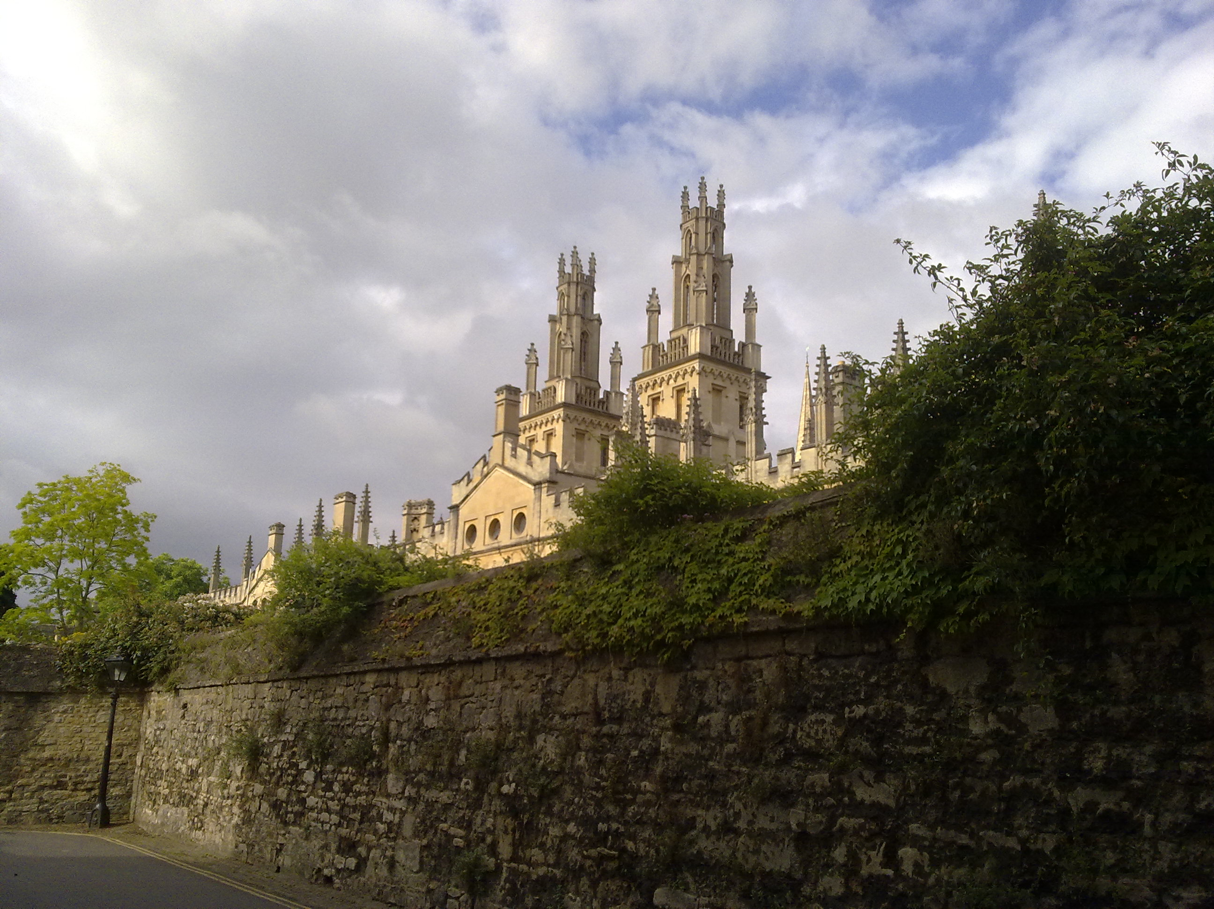




From the Ivory Tower…
Source: Wikipedia (All Souls College, Oxford)

Slide 4
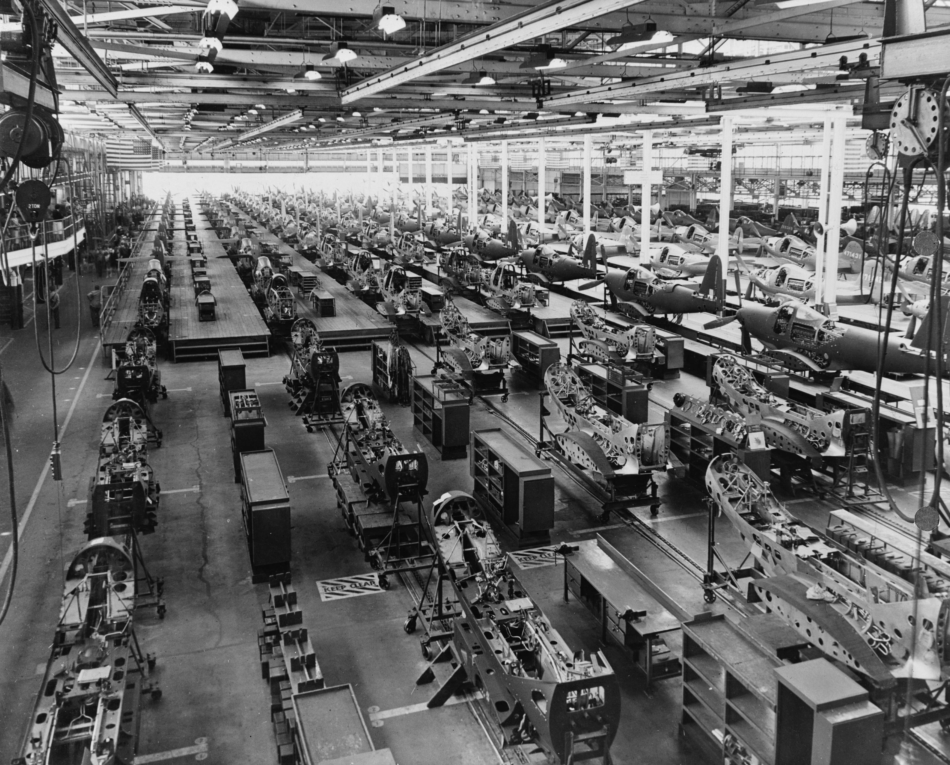
… to building sh*t that works
Source: Wikipedia (Factory)

Slide 5

… and back!
Source: Wikipedia (All Souls College, Oxford)

Slide 6
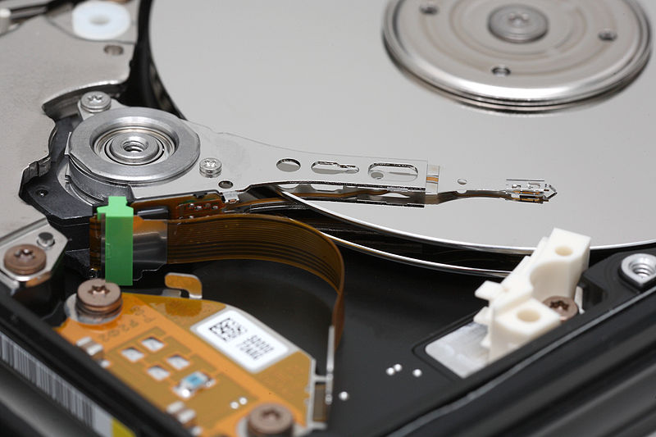
Big Data
Source: Wikipedia (Hard disk drive)

Slide 7








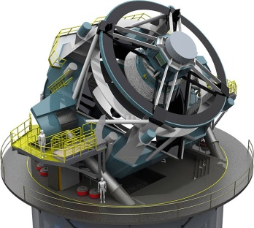


Processes 20 PB a day (2008)
Crawls 20B web pages a day (2012)
Search index is 100+ PB (5/2014)
Bigtable serves 2+ EB, 600M QPS (5/2014)
400B pages, 10+ PB (2/2014)
19 Hadoop clusters: 600 PB, 40k servers (9/2015)
Hadoop: 10K nodes, 150K cores, 150 PB (4/2014)
150 PB on 50k+ servers running 15k apps (6/2011)
300 PB data in Hive + 600 TB/day (4/2014)
LHC: ~15 PB a year
S3: 2T objects, 1.1M request/second (4/2013)
640K ought to be enough for anybody.
LSST: 6-10 PB a year (~2020)
SKA: 0.3 – 1.5 EB per year (~2020)
How much data?

Slide 8

Why big data?
Science
Business
Society
Source: Wikipedia (Everest)

Slide 9
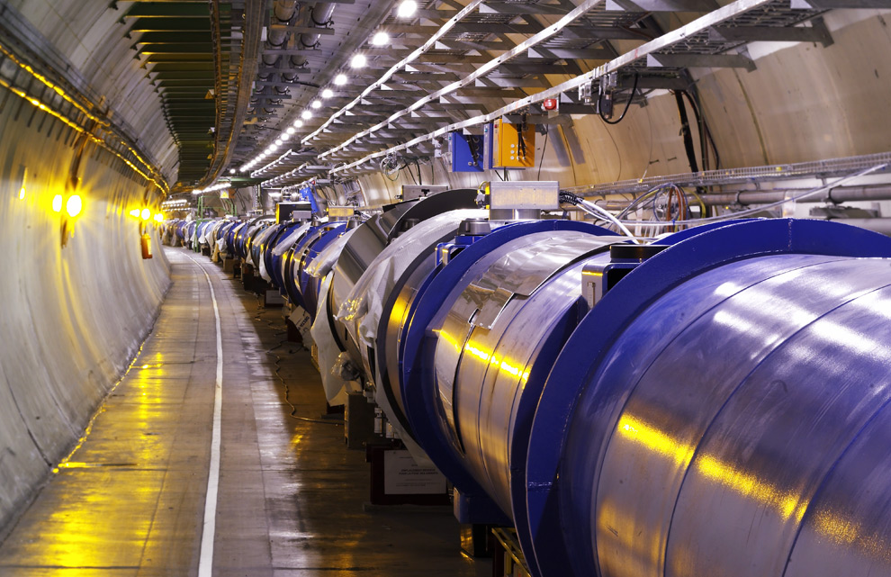
Science
Emergence of the 4th Paradigm
Data-intensive e-Science
Maximilien Brice, © CERN
Notes:
By the time it shuts down in 2011, the CERN collider should have amassed about 20 times as much data as it now has. (NYTimes article, “Trillions of Reasons to Be Excited”, 11/1/2010)

Slide 10

Business
Data-driven decisions
Data-driven products
Source: Wikiedia (Shinjuku, Tokyo)

Slide 11
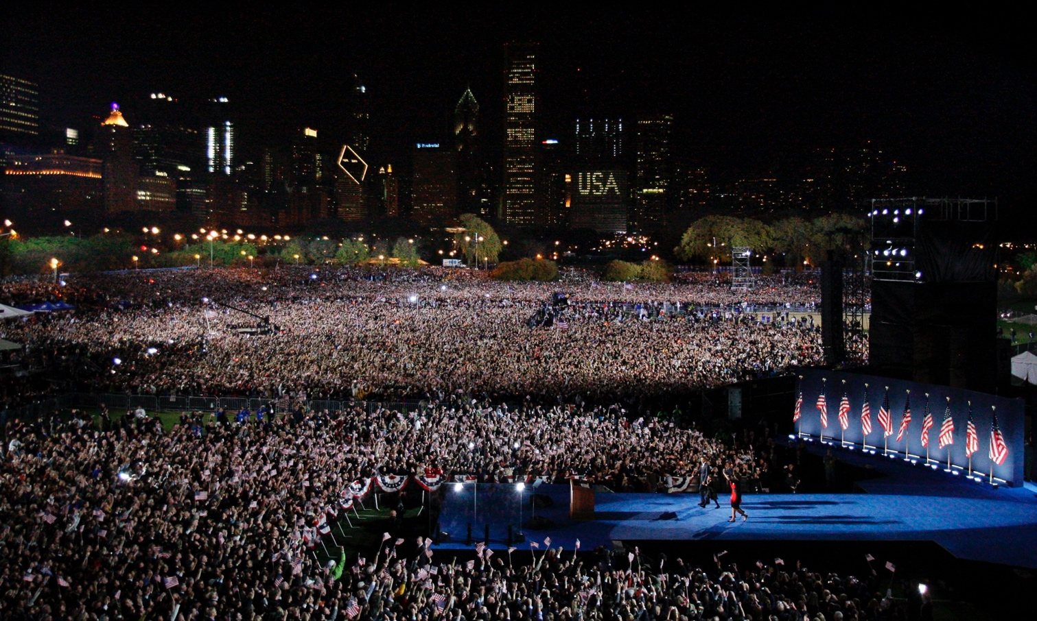
Society
Humans as social sensors
Computational social science
Source: Guardian

Slide 12

Source: Popular Internet Meme

Slide 13
What is this course about?
Data Science
Tools
This Course
Analytics Infrastructure
Execution Infrastructure
“big data stack”

Slide 14
Buzzwords
Text: frequency estimation, language models, inverted indexes
Graphs: graph traversals, random walks (PageRank)
Relational data: SQL, joins, column stores
Data mining: hashing, clustering (k-means), classification, recommendations
Streams: probabilistic data structures (Bloom filters, CMS, HLL counters)
data science, data analytics, business intelligence, data warehouses and data lakes
Data Science
Tools
This Course
Analytics Infrastructure
MapReduce, Spark, Flink, Pig, Dryad, Hive, Dryad, noSQL, Pregel, Giraph, Storm/Heron
Execution Infrastructure
“big data stack”
This course focuses on algorithm design and “thinking at scale”

Slide 15
Structure of the Course
Analyzing Text
Analyzing Relational Data
Analyzing Graphs
Data Mining and Machine Learning
What’s beyond batch processing?
“Core” framework features and algorithm design for batch processing

Slide 16
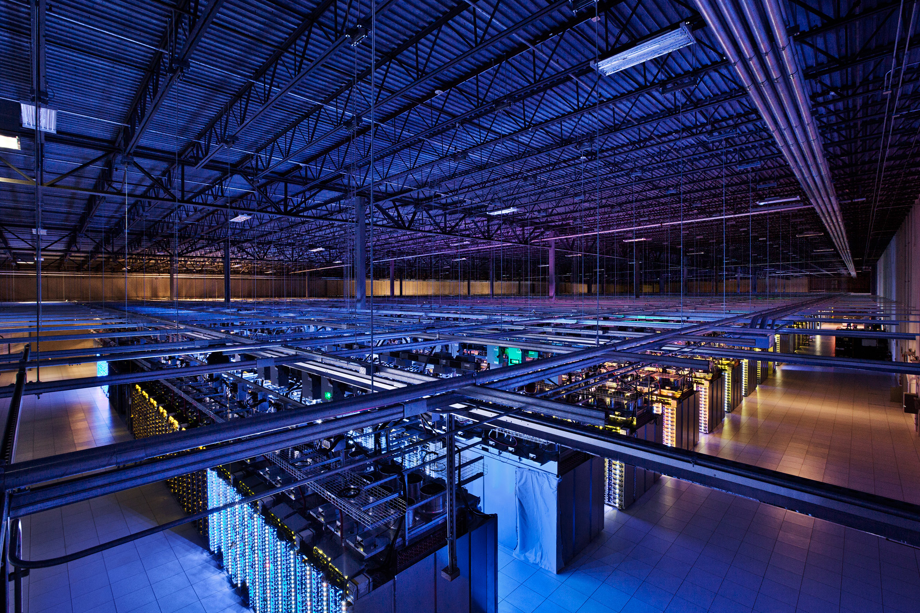
Tackling Big Data
Source: Google

Slide 17
Divide and Conquer
“Work”
Partition
w₁
w₂
w₃
worker
worker
worker
r₁
r₂
r₃
Aggregate
“Result”

Slide 18
Parallelization Challenges
How do we assign work units to workers?
What if we have more work units than workers?
What if workers need to communicate partial results?
What if workers need to access shared resources?
How do we know when a worker has finished? (Or is simply waiting?)
What if workers die?
Difficult because:
We don’t know the order in which workers run…
We don’t know when workers interrupt each other…
We don’t know when workers need to communicate partial results…
We don’t know the order in which workers access shared resources…
What’s the common theme of all of these challenges?

Slide 19
Common Theme?
Parallelization challenges arise from:
Need to communicate partial results
Need to access shared resources
(In other words, sharing state)
How do we tackle these challenges?

Slide 20
“Current” Tools
Basic primitives
Semaphores (lock, unlock)
Conditional variables (wait, notify, broadcast)
Barriers
Awareness of Common Problems
Deadlock, livelock, race conditions...
Dining philosophers, sleeping barbers, cigarette smokers...

Slide 21
“Current” Tools
Programming Models
Shared Memory
Message Passing
Memory
P₁
P₂
P₃
P₄
P₅
P₁
P₂
P₃
P₄
P₅
Design Patterns
producer
consumer
coordinator
work queue
workers
producer
consumer

Slide 22
When Theory Meets Practices
Concurrency is already difficult to reason about…
Now throw in:
The scale of clusters and (multiple) datacenters
The presence of hardware failures and software bugs
The presence of multiple interacting services
The reality:
Lots of one-off solutions, custom code
Write you own dedicated library, then program with it
Burden on the programmer to explicitly manage everything
Bottom line: it’s hard!

Slide 23
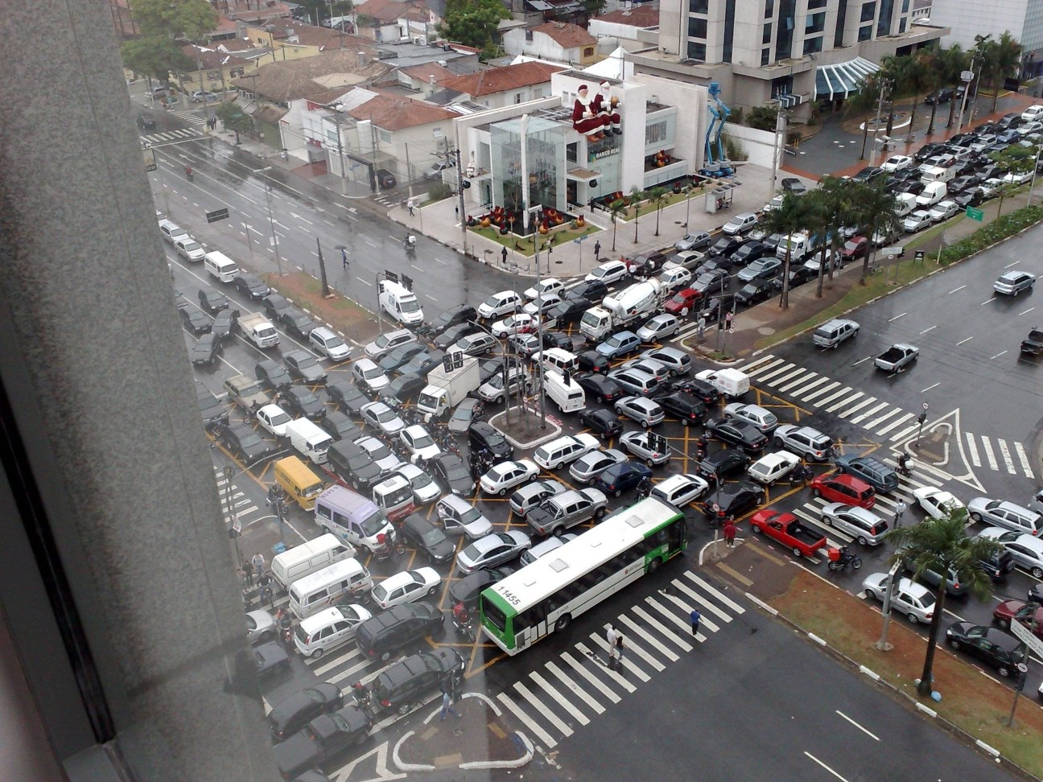
Source: Ricardo Guimarães Herrmann

Slide 24
Source: CS 251

Slide 25
✗
Source: CS 251

Slide 26
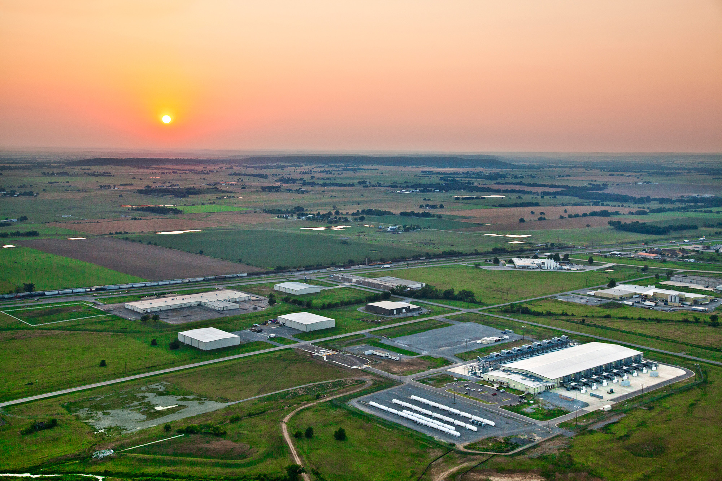
The datacenter is the computer!
Source: Google

Slide 27
The datacenter is the computer!
It’s all about the right level of abstraction
Moving beyond the von Neumann architecture
What’s the “instruction set” of the datacenter computer?
Hide system-level details from the developers
No more race conditions, lock contention, etc.
No need to explicitly worry about reliability, fault tolerance, etc.
Separating the what from the how
Developer specifies the computation that needs to be performed
Execution framework (“runtime”) handles actual execution
MapReduce is the first instantiation of this idea… but not the last!

Slide 28
MapReduce
Source: Google

Slide 29
What’s different?
Data-intensive vs. Compute-intensive
Focus on data-parallel abstractions
Coarse-grained vs. Fine-grained parallelism
Focus on coarse-grained data-parallel abstractions

Slide 30
Logical vs. Physical
Different levels of design:
“Logical” deals with abstract organizations of computing
“Physical” deals with how those abstractions are realized
Examples:
Scheduling
Operators
Data models
Network topology
Why is this important?

Slide 31
Roots in Functional Programming
Simplest data-parallel abstraction
Process a large number of records: “do” something to each
Map
f
f
f
f
f
We need something more for sharing partial results across records!

Slide 32
Roots in Functional Programming
Let’s add in aggregation!
Map
f
f
f
f
f
Fold
g
g
g
g
g
MapReduce = Functional programming + distributed computing!

Slide 33
Functional Programming in Scala
scala> val t = Array(1, 2, 3, 4, 5)
t: Array[Int] = Array(1, 2, 3, 4, 5)
scala> t.map(n => n*n)
res0: Array[Int] = Array(1, 4, 9, 16, 25)
scala> t.map(n => n*n).foldLeft(0)((m, n) => m + n)
res1: Int = 55
Imagine parallelizing the map and fold across a cluster…

Slide 34
A Data-Parallel Abstraction
Process a large number of records
Map
“Do something” to each
Group intermediate results
“Aggregate” intermediate results
Reduce
Write final results
Key idea: provide a functional abstraction for these two operations

Slide 35
MapReduce
Programmer specifies two functions:
map (k₁, v₁) → List[(k₂, v₂)]
reduce (k₂, List[v₂]) → List[(k₃, v₃)]
All values with the same key are sent to the same reducer
What does this actually mean?
The execution framework handles everything else…

Slide 36
k₁
v₁
k₂
v₂
k₃
v₃
k₄
v₄
k₅
v₅
k₆
v₆
map
map
map
map
a
1
b
2
c
3
c
6
a
5
c
2
b
7
c
8
group values by key
a
1
5
b
2
7
c
2
3
6
8
reduce
reduce
reduce
r₁
s₁
r₂
s₂
r₃
s₃

Slide 37
MapReduce
Programmer specifies two functions:
map (k₁, v₁) → List[(k₂, v₂)]
reduce (k₂, List[v₂]) → List[(k₃, v₃)]
All values with the same key are sent to the same reducer
The execution framework handles everything else…
What’s “everything else”?

Slide 38
MapReduce “Runtime”
Handles scheduling
Assigns workers to map and reduce tasks
Handles “data distribution”
Moves processes to data
Handles synchronization
Groups intermediate data
Handles errors and faults
Detects worker failures and restarts
Everything happens on top of a distributed FS (later)

Slide 39
MapReduce
Programmer specifies two functions:
map (k₁, v₁) → List[(k₂, v₂)]
reduce (k₂, List[v₂]) → List[(k₃, v₃)]
All values with the same key are sent to the same reducer
The execution framework handles everything else…
Not quite…

Slide 40
k₁
v₁
k₂
v₂
k₃
v₃
k₄
v₄
k₅
v₅
k₆
v₆
map
map
map
map
a
1
b
2
c
3
c
6
a
5
c
2
b
7
c
8
group values by key
a
1
5
b
2
7
c
2
3
6
8
reduce
reduce
reduce
r₁
s₁
r₂
s₂
r₃
s₃
What’s the most complex and slowest operation here?

Slide 41
MapReduce
four
✗
Programmer specifies two functions:
map (k₁, v₁) → List[(k₂, v₂)]
reduce (k₂, List[v₂]) → List[(k₃, v₃)]
All values with the same key are sent to the same reducer
partition (k', p) → 0 ... p-1
Often a simple hash of the key, e.g., hash(k') mod n
Divides up key space for parallel reduce operations
combine (k₂, List[v₂]) → List[(k₂, v₂)]
Mini-reducers that run in memory after the map phase
Used as an optimization to reduce network traffic

Slide 42
k₁
v₁
k₂
v₂
k₃
v₃
k₄
v₄
k₅
v₅
k₆
v₆
map
map
map
map
a
1
b
2
c
3
c
6
a
5
c
2
b
7
c
8
combine
combine
combine
combine
a
1
b
2
c
9
a
5
c
2
b
7
c
8
partition
partition
partition
partition
group values by key
a
1
5
b
2
7
c
c
2
2
9
3
8
6
8
*
*
*
reduce
reduce
reduce
r₁
s₁
r₂
s₂
r₃
s₃
* Important detail: reducers process keys in sorted order

Slide 43
“Hello World” MapReduce: Word Count
def map(key: Long, value: String) = {
for (word <- tokenize(value)) {
emit(word, 1)
}
}
def reduce(key: String, values: Iterable[Int]) = {
for (value <- values) {
sum += value
}
emit(key, sum)
}

Slide 44
MapReduce can refer to…
The programming model
The execution framework (aka “runtime”)
The specific implementation
Usage is usually clear from context!

Slide 45

MapReduce Implementations
Google has a proprietary implementation in C++
Bindings in Java, Python
Hadoop provides an open-source implementation in Java
Development begun by Yahoo, later an Apache project
Used in production at Facebook, Twitter, LinkedIn, Netflix, …
Large and expanding software ecosystem
Potential point of confusion: Hadoop is more than MapReduce today
Lots of custom research implementations

Slide 46

Course Administrivia
Source: http://www.flickr.com/photos/artmind_etcetera/6336693594/

Slide 47
Important Coordinates
Course website:
http://lintool.github.io/bigdata-2018f/
Lots of info there, read it!
(“I didn’t see it” will not be accepted as an excuse)
Communicating with us:
Piazza for general questions (link on course homepage)
uwaterloo-bigdata-2018f-staff@googlegroups.com
(Mailing list reaches all course staff – use Piazza unless it’s personal)
Bespin
http://bespin.io/

Slide 48
Course Design
This course focuses on algorithm design and “thinking at scale”
Not the “mechanics” (API, command-line invocations, et.)
You’re expected to pick up MapReduce/Spark with minimal help
Components of the final grade:
8 individual assignments
Final exam
Additional group final project (CS 651)

Slide 49
Expectations
Your background:
Pre-reqs: CS 341, CS 348, CS 350
Comfortable in Java and Scala (or be ready to pick it up quickly)
Know how to use Git
Reasonable “command-line”-fu skills
Experience in compiling, patching, and installing open source software
Good debugging skills
You are:
Genuinely interested in the topic
Be prepared to put in the time
Comfortable with rapidly-evolving software

Slide 50
MapReduce/Spark Environments
See “Software” page in course homepage for instructions
Single-Node Hadoop: Linux Student CS Environment
Everything is set up for you, just follow instructions
We’ll make sure everything works
Single-Node Hadoop: Local installations
Install all software components on your own machine
Requires at least 4GB RAM and plenty of disk space
Works fine on Mac and Linux, YMMV on Windows
Important: For your convenience only!
We’ll provide basic instructions, but not technical support
Distributed Hadoop: Datasci Cluster
New feature this offering!

Slide 51
Assignment Mechanics
We’ll be using private GitHub repos for assignments
Complete your assignments, push to GitHub
We’ll pull your repos at the deadline and grade
Note late policy (details on course homepage)
Late by up to 24 hours: 25% reduction in grade
Late 24-48 hours: 50% reduction in grade
Late by more the 48 hours: not accepted
By assumption, we’ll pull and mark at deadline: If you want us to hold off, you must let us know!
Important: Register for (free) GitHub educational account!
https://education.github.com/discount_requests/new

Slide 52
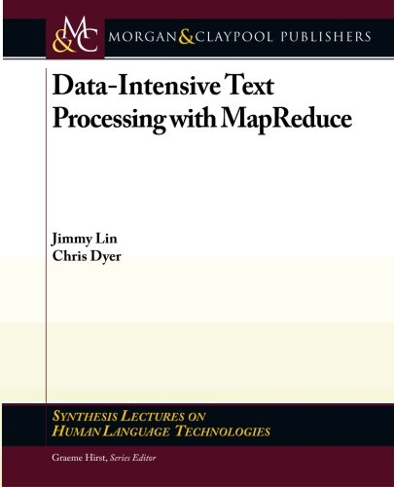
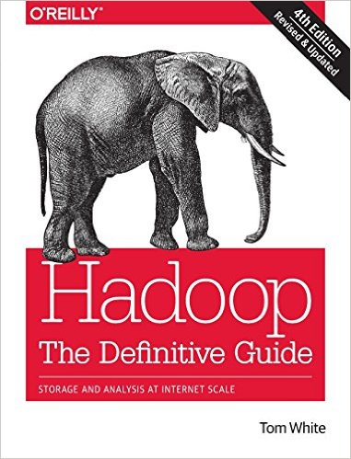

Course Materials
One (required) textbook +
Two (optional but recommended) books +
Additional readings from other sources as appropriate
Note: 4th Edition
(optional but recommended)

Slide 53
If you’re not (yet) registered:
Register for the wait list at:
https://goo.gl/forms/7LA2QxBVXhESw8O43
Registration begins at 8pm Thursday September 6th
Priority for unregistered students
CS students
Have all the pre-reqs
Final opportunity to take the course (e.g., 4B students)
| form submission time – 8pm 9/6/2018 |
Continue to attend class until final decision
Note: late registration is not an excuse for late assignments

Slide 54

Luke: I won’t fail you. I’m not afraid.
Yoda: You will be. You... will... be.

Slide 55

Be prepared…
Source: Wikipedia (The Scream)

Slide 56
“Hadoop Zen”
Parts of the ecosystem are still immature
We’ve come a long way since 2007, but still far to go…
Bugs, undocumented “features”, inexplicable behavior, etc.
Different versions = major pain
Don’t get frustrated (take a deep breath)…
Those W$*#T@F! moments
Be patient…
We will inevitably encounter “situations” along the way
Be flexible…
We will have to be creative in workarounds
Be constructive…
Tell me how I can make everyone’s experience better

Slide 57

“Hadoop Zen”
Source: Wikipedia (Japanese rock garden)

Slide 58
Questions?
To Do:
1. Bookmark course homepage
2. Get on Piazza
3. Register for GitHub educational account (CS 451)
Source: Wikipedia (Japanese rock garden)

